Slide 1
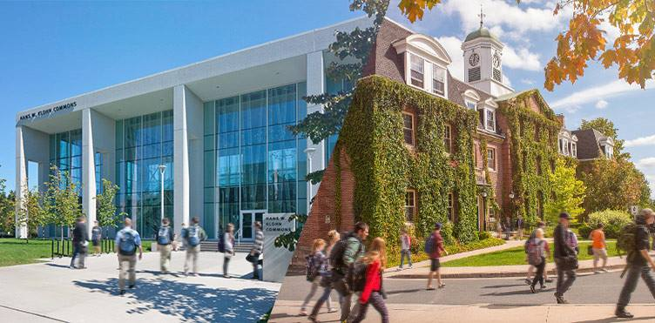
New Brunswick’s R&D and Innovation Ecosystem (2019)
November 19, 2019
Presented by:
Robert Crawhall, Senior Partner
Omer Kaya, Associate Partner
Global Advantage Consulting Group Inc.
Notes:
Make NB logo smaller and add UNB logo

Slide 2
Contents
Introduction
  Project Objectives, Methodology and Data Sources
  New Brunswick R&D and Innovation Ecosystem Map (2019)
New Brunswick Overall R&D/Innovation Performance
  R&D in New Brunswick
  Provincial Innovation Rankings
New Brunswick R&D Innovation Ecosystem Stakeholders
  Federal Government
  Higher Education
    University of New Brunswick
  Provincial Government
  Not-For-Profits Operating in NB
  Private Sector
  Global Markets
Key Observations and Recommendations

Slide 3
Introduction

Slide 4
Project Objective, Methodology and Data Sources
Objective: To map the key R&D/Innovation stakeholders and their activities in the province of New Brunswick, including provincial and federal governments, higher education institutions (universities/colleges), the private sector (SMEs, large firms, risk capital), innovation networks and associations, and links to global markets
Methodology and Data Sources:
Employ a systematic review approach which involves finding, assessing, and analysing reliable, publicly available data
Identify and assess all key government, higher education, private sector, and global market stakeholders within New Brunswick’s innovation ecosystem, as well as the flows of money, information, people, and material between them
Analyze existing literature on strategic plans, workforce forecasts, critical infrastructures, industry capabilities, and R&D initiatives/programs
Employ both qualitative (analysis of data of opinions and arguments from written documents) and quantitative research methods (analysis of trends and patterns through statistical agencies) to understand the scope and impact of innovation and R&D activity in New Brunswick
Identify key challenges and opportunities in creating thriving innovation ecosystem/cluster in NB by analyzing important variables including legislation, risk capital flows, higher education capabilities, talent pipeline, private-public-academic modalities for collaboration, government programs, cluster-development, etc.

Slide 5
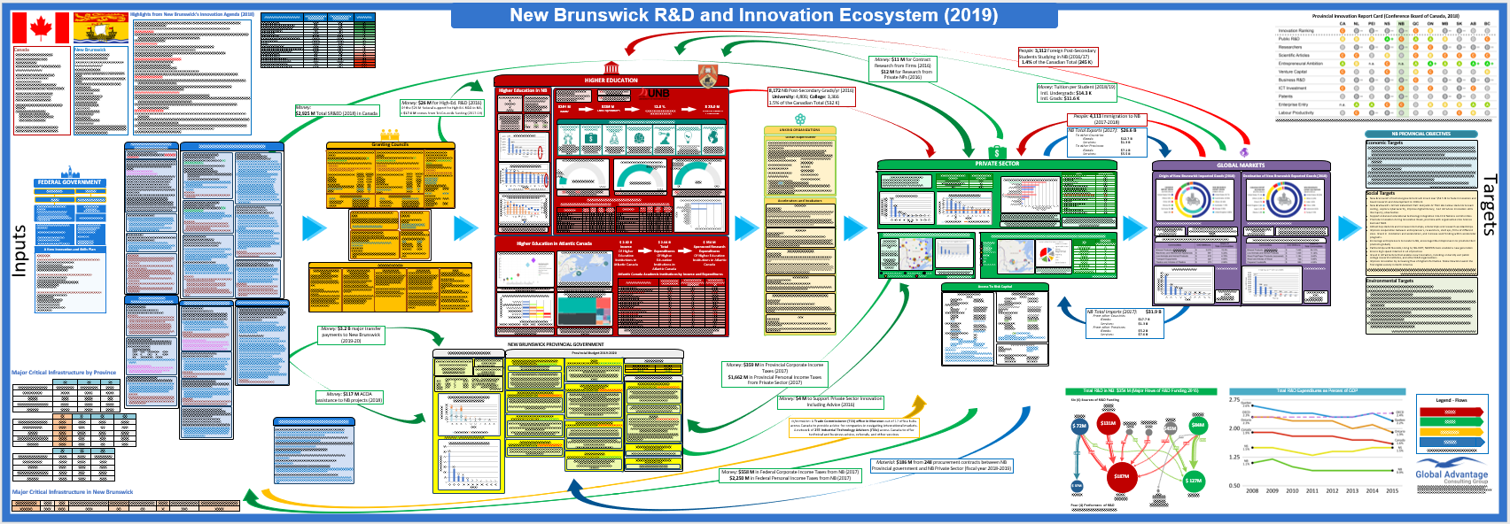
New Brunswick R&D and Innovation Ecosystem Map (2019)
Federal Government
Government of New Brunswick
Higher Education
Linking Organizations
Global Markets
Granting Councils
Private Sector
Ecosystem Targets
The arrows between stakeholders show the flow of Money, People, Information, and Materials

Slide 6
Executive Summary of Observations
NB’s R&D gap: in R&D performance metrics NB scores among the lowest provinces in Canada
Total spending: GERD (9th of 10), BERD (8th of 10), HERD (9th of 10), GovERD funded (9th of 10)
UNB leads higher education research and innovation in New Brunswick
UNB contributes 70% of NB’s sponsored research, and spends 12.8% of total expenditures on sponsored research, which is double Atlantic Canada’s average.
NB’s private sector lags with respect to innovation
While over 50% of total Canadian R&D spending is performed by the private sector, only about a third of R&D in NB is performed by the private sector. This is a trend with all the Maritimes.
NB’s government underperforms in supporting innovation and research
NB’s 2019-20 budget does not have a strong innovation focus: funding to innovation-focused departments and programs has in general been reduced.
Although NB demonstrated high export growth last year, it is heavily reliant on the US market
90% of NB exports are to the US, rendering the province vulnerable to trade instability.
% of GDP: GERD (7th of 10), BERD (7th of 10), HERD (8th of 10), GovERD funded (10th of 10)
Per capita: GERD (10th of 10), BERD, (8th of 10), HERD (10th of 10), GovERD funded (10th of 10)
It is unclear how the new NB government will accomplish its goal of NB becoming the dominant cybersecurity player in Canada. NB’s 10 Year Education Plan’s cyber focus will need to increase the cyber talent pool. NB’s private sector needs more cyber talent.
UNB’s 7 strategic research areas and newly created cannabis research chair position align with the provinces’ key research areas of smart grid, big data, cybersecurity and cannabis.
NB private sector comprises 99.8% of SMEs with very few large companies (500+ employees).
UNB is contributing to the NB government’s goal of improving and attracting innovative talent. This is a good step to improve the private sector’s innovation contribution.
In terms of export sectors, NB relies on mineral products (59%), most of which are oil, petroleum and gas products.
A longer term trade diversification strategy will be important for economic stability.
1
2
3
4
5

Slide 7
Executive Summary of Recommendations
Increase the talent pool in the province to help attract large companies and investments to NB
Attract new talent: Create college-like programs that quickly produce talent to support key industries (e.g. cybersecurity, clean tech etc.)
Collaborate between the higher education, prov/fed governments, NFPs, and private sector stakeholders
Leverage existing Supercluster initiatives with a particular attention to the Ocean Supercluster and Scale.AI for supply chains
Develop a strategy to attract federal government and private sector investments
Federal investments: Take advantage of federal programs (e.g. $80M for new cyber networks, ISED-SIF, Tri-Councils, DND-SSE/IDEaS)
Enhance technology adoption among SMEs in NB
Due to limited investments/R&D efforts in the province, NB should instead focus on the adoption of new technologies by SMEs
Create a provincial export strategy
Set tangible export goals and determine key export markets to maintain export growth
Stop outmigration: Provide incentives and infrastructure for companies to relocate (e.g. create cyber parks)
Focus on innovation only in certain areas of strength with high potential (clean tech, cyber, natural resources)
Decide how to pursue the goal of becoming Canada’s leader in cybersecurity
Take advantage of Economic Strategy Tables including the new Tourism Table (Budget 2019)
Private sector: Develop a Special Economic Zone strategy to attract established Canadian companies to the province as well as foreign direct investments
Diversifying both export partners, markets and products would decrease dependence on the US as a trading partner
1
2
3
4
5

Slide 8
New Brunswick Overall
R&D/Innovation Performance

Slide 9
R&D in New Brunswick
NB performed $354 M in R&D in 2016
  This is about 1% of the $34.5 B spent on R&D in Canada
Business performs only 36% of all R&D in NB and higher education performs 53%
  Across Canada, business performed 53% of all R&D and Higher Education performed 40%
The provincial government is a minor funder ($11 M) and performer ($3 M) of R&D in NB

Slide 10
R&D in New Brunswick
New Brunswick’s GERD/GDP, which was 0.9% in 2015, has been consistently lower than the national average of 1.6%
NB’s GERD/GDP peaked in 2009 and has been decreasing since

Slide 11
Provincial Innovation Rankings
Along with 5 other provinces, NB has the lowest Innovation Ranking, D-
Unlike every other province, in all the categories surveyed, NB did not receive higher than a C grade
NB has very few researchers engaged in R&D, and very few scientific articles published
On the positive side, total value and number of Venture Capital deals have grown in NB in recent years
Relative strengths include public R&D, ICT investments and enterprise entry
Source: Conference Board of Canada

Slide 12
Federal Government

Slide 13
Key Selected Federal Government R&D/Innovation Support to NB
Federal Departments
ISED $3.1 M for the establishment of the Cybersecurity Innovation Centre in Fredericton (August 2018) contributing to NB’s Innovation Agenda goal of Leading the Cybersecurity Agenda in Canada
  NB can access to SIF ($1.26 B over 5 years), ISC (over $100 M from 20 federal departments), and BCIP
GAC Trade Commissioner Service office in Moncton
  NB can access to Export Diversification Strategy ($1.1 B over 6 years)
NRCan Atlantic Forestry Centre Fredericton
  $4.1 M towards an ongoing smart grid and energy storage project in Saint John
  NB can access to $145 M over 5 years towards protecting critical infrastructure from cyber threats
NRC Institute for Information Technology at UNB in Fredericton and digital technologies research facilities in Moncton
DFO, ECCC and AAFC have research facilities across NB
Regional Development Agencies
ACOA provided $92 M in assistance to NB economic projects in 2018-19
Federal Granting Councils
Tri-Councils provided $17.6 M, or only 0.8% of total Canadian grant money ($2.2 B) to NB in 2017/18
  NSERC: $11.6 M (has been declining since FY 2011-12) ; SSHRC: $4 M ; CIHR: $2 M
  Canada Research Chairs Program: 1,614 positions in CA, only 17 are in NB (11 are at the UNB)

Slide 14
Higher Education

Slide 15
Higher Education Overview
New Brunswick has 9 major universities and 5 major colleges
In New Brunswick in 2016-17, there were 27,350 post-secondary students studying (about 1.3% of Canada’s total)
  19,430 at universities
  7,920 at colleges
  24,050 were Canadian; 3,300 were international students
8,175 graduated in 2016 (1.5% of Canada’s total)
In 2016, Higher Education in NB performed only $187 M in R&D. It ranked
  Canada’s 2nd lowest (9/10) provincial performer, ahead only of PEI
  Last in Higher Education R&D per capita by province
Source: Statistics Canada

Slide 16
UNB: Contribution to Provincial and Atlantic Canada HERD
UNB is the leader in sponsored research in NB
The University of New Brunswick performs $39 M of the total $55.9 M sponsored research in NB (69.8%)
UNB contributes 11% of Atlantic Canada’s sponsored research
This makes UNB the third largest contributor to sponsored research in Atlantic Canada, only behind the universities of Dalhousie ($145.2 M, 41% of total Atlantic sponsored research) and Memorial ($111.8 M, 32% of Atlantic sponsored research)
Source: CAUBO, Financial Information on Universities and Colleges, 2016-17 Fiscal Year (most up to date)

Slide 17
University of New Brunswick: Strategic Research Plan
UNB’s Strategic Research Plan’s has a multidisciplinary focus and its 7 key research areas involve research from all broad academic disciplines
The Digital Society, Computing and Mathematical Foundations key research area’s cybersecurity focus overlaps with the New Brunswick 2018 Innovation Agenda, which lists cybersecurity as one of its six key priorities
The Energy, Natural Resources and Sustainable Development focus on smart grid technology overlaps with New Brunswick 2018 Innovation Agenda’s goal of growing post-secondary-led research in smart grid and other key areas

Slide 18
Provincial Government Support for R&D/Innovation Activities

Slide 19
Highlights from New Brunswick’s Innovation Agenda (April 2018)
New Brunswick’s government plans to invest over $53.5 M in innovation and R&D in New Brunswick from 2018-19. Included are key themes, such as:
1. Attract and Expand the Talent and Knowledge Base
Attract and increase students graduating in innovative (STEM) fields.
Attract innovative companies
Increase research cooperation with higher education and private sector
2. Encourage Entrepreneurship
Via supporting commercial opportunities and promoting an entrepreneurship culture
Allow easy access to digital information and databases for innovation within the private sector and higher education
3. Cybersecurity as the Key Industry
Cybersecurity is the key industry: NB’s government aims for the province to be the “cybersecurity” leader of Canada, hosting top business and academic talent
Other industries are mentioned (Smart Grid, Cannabis). However, Cybersecurity is the government’s key focus
Note: The document is qualitative rather than quantitative: NB’s Innovation Agenda is a set of guiding principles and general goals, rather than specific monetary or employment targets

Slide 20
Key Select Provincial Crown Corporations
Opportunities New Brunswick (ONB) is an economic development agency that operates as a crown corporation
  Considering Cybersecurity is the most important innovative industry as per the NB government’s innovation agenda, ONB’s CyberNB is an important player in NB’s innovation space
CyberNB operates out of ONB and is responsible for improving cybersecurity talent, protecting critical infrastructure, supporting start-ups and new product development, and facilitating cyber R&D
  As a result, CyberNB makes a significant public sector contribution to the goal of Leading the Cybersecurity Agenda in Canada
Cybersecurity Innovation Centre: Announced August 2018, the Centre fosters partnership between government, academia and the private sector. The initiative has received a $3.1 M loan from the federal government
Regional Development Corporation: plans, coordinates and implements regional and economic development initiatives and projects in NB
  Annual budget for innovation: $17 M - $18 M
  About $7.2 M goes to NBIF, $4.3 M goes to the NBHRF, $1 M to incubators/accelerators, and remaining funds to misc. university infrastructure projects
  RDC allocates $45 M towards development initiatives
New Brunswick’s health networks spent $25.2 M on research in 2017-18 according to their latest annual reports

Slide 21
Not-For-Profits and Linking Organizations

Slide 22
Key Select Not-For-Profits and Linking Organizations in NB
New Brunswick Innovation Foundation is the premier venture capital and research investment NFP in New Brunswick. It has invested over $100 M in the province
Mitacs supports research-based innovation, and although it is Canada-wide, it has funded 143 projects in New Brunswick, 91% of which were science based
Most of New Brunswick’s accelerators and incubators are located in Moncton, Fredericton and Saint John, and offer funding, mentorship and business related courses. Examples:
Scale Up Atlantic Canada,
Pond-Deshpande Centre,
Planet Hatch etc.
Ocean Supercluster: based in Atlantic Canada and is focused on using data and autonomous systems to predict and enhance Canada’s maritime and ocean economy
  Notable New Brunswick collaborators include Academia: UNB and NB Community College; Private sector: Envenio, Irving shipbuilding, Atlantic Towing, Teledyne CARIS; International Companies: Microsoft, IBM, Cisco, Siemens

Slide 23
Private Sector R&D and Innovation

Slide 24
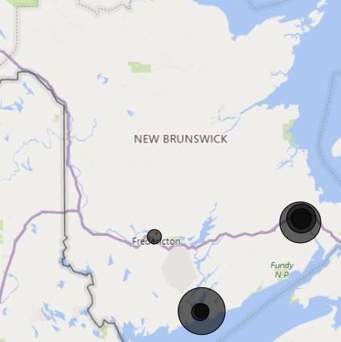
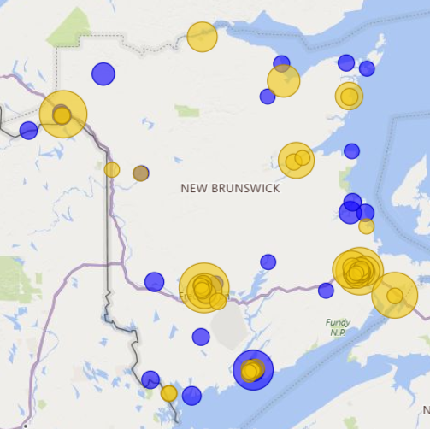
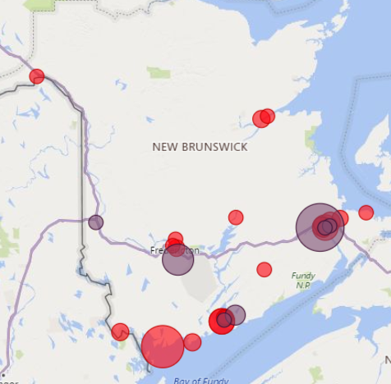
Large and Medium Businesses (200+ employees) by Location and Sector
The majority of NB’s large and medium sized businesses are located in Moncton, Fredericton and Saint John
  Tech companies are mostly located in the Moncton and Saint John areas
  Industry/Manufacturing/Construction & Services companies are dispersed across NB
  Retail and Trade & Transport and Warehousing are located in the southern half of the province
Note: larger bubble sizes represent larger employers
(Source: D&B Hoovers, 2019)

Slide 25
Innovative Businesses (<100 employees) by Location and Sector
Saint John hosts a large percentage of innovative Software and Hardware companies
Fredericton’s and Moncton’s innovative small businesses are more diversified across industries
New Brunswick Small Businesses (Less than 100 Employees) by Sector and Location
(Source: Hockeystick, 2019)

Slide 26
Business Expenditure on R&D
According to Statistics Canada, New Brunswick businesses performed $127 M in R&D, or 36% of total R&D in New Brunswick. This is far below the 53% Canadian average
NB BERD ranked 7th with respect to BERD/GDP, and 8th with respect to BERD per capita. NB BERD performance is on par with other Atlantic Canada provinces
Source: Statistics Canada

Slide 27
Global Markets

Slide 28
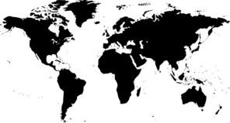

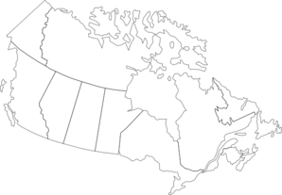
New Brunswick Trade Overview
NB exported $26.6 B worth of goods and services in 2017, while importing $31.9 B
NB had a negative trade balance of -$5.3 B
Global Trade
Canadian Trade
$14.0 B
$12.6 M
-$5 B
-$200 M
$19.0 B
$12.8 B
Source: Statistics Canada

Slide 29
Diversification in Trade: Exports
NB’s top 5 export destinations are US (90.2%), India (1.02%) and China (1.00%)
  Top exports to US: 1. Light oils and Preparations (29.63%), 2. Petroleum oils and other oils (23.35%), 3. Lumber (4.65%)
  Top exports to India: 1. Chemical Woodpulp (Dissolving Grades) (95.79%), 2. Lead (1.83%), 3. Thermometers and Pyrometers (0.51%)
  Top exports to China: 1. Chemical Woodpulp (Dissolving Grades) (39.55%), 2. Atlantic/Danube Salmon (13.97%), 3. Crabs (13.66%)
NB export destinations are much less diversified than Canada’s, with exports to the U.S. constituting 90.2% of all exports
  In comparison, the US represents 75.1% of Canadian export destinations
  This is in contrast to NB’s import origins, which are more diversified compared to Canada
NB’s exporters’ high dependence on the US leaves them in a vulnerable position
Source: Innovation, Science and Economic Development Canada (2018)

Slide 30
Observations and Recommendations

Slide 31
Summary of Key Observations
NB’s R&D gap: in R&D performance metrics NB scores among the lowest provinces in Canada
  Total spending: GERD (9th of 10), BERD (8th of 10), HERD (9th of 10), GovERD funded (9th of 10)
  % of GDP: GERD (7th of 10), BERD (7th of 10), HERD (8th of 10), GovERD funded (10th of 10)
  Per capita: GERD (10th of 10), BERD, (8th of 10), HERD (10th of 10), GovERD funded (10th of 10)
NB’s government underperforms in supporting innovation and research
  NB’s 2019-20 budget does not have a strong innovation focus: funding to innovation-focused departments and programs has in general been reduced.
  It is unclear how the new NB government will accomplish its goal of NB becoming the dominant cybersecurity player in Canada. NB’s 10 Year Education Plan’s cyber focus will need to increase the cyber talent pool. NB’s private sector needs more cyber talent.
UNB leads higher education research and innovation in New Brunswick
  UNB contributes 70% of NB’s sponsored research, and spends 12.8% of total expenditures on sponsored research, which is double Atlantic Canada’s average.
  UNB’s 7 strategic research areas and newly created cannabis research chair position align with the provinces’ key research areas of smart grid, big data, cybersecurity and cannabis.
NB’s private sector lags with respect to innovation
  While over 50% of total Canadian R&D spending is performed by the private sector, only about a third of R&D in NB is performed by the private sector. This is a trend with all the Maritimes.
  NB private sector comprises 99.8% of SMEs with very few large companies (500+ employees).
  UNB is contributing to the NB government’s goal of improving and attracting innovative talent. This is a good step to improve the private sector’s innovation contribution.
Although NB demonstrated high export growth last year, it is heavily reliant on the US market
  90% of NB exports are to the US, rendering the province vulnerable to trade instability.
  In terms of export sectors, NB relies on mineral products (59%), most of which are oil, petroleum and gas products.
  A longer term trade diversification strategy will be important for economic stability.

Slide 32
Key Recommendations to Consider
Increase the talent pool in the province to help attract large companies and investments to NB
  Attract new talent: Create college-like programs that quickly produce talent to support key industries (e.g. cybersecurity, clean tech etc.)
  Stop outmigration: Provide incentives and infrastructure for companies to relocate (e.g. create cyber parks)
Enhance technology adoption among SMEs in NB
  Due to limited investments/R&D efforts in the province, NB should instead focus on the adoption of new technologies by SMEs
  Focus on innovation only in certain areas of strength with high potential (clean tech, cyber, natural resources)
  Decide how to pursue the goal of becoming Canada’s leader in cybersecurity
Collaborate between the higher education, prov/fed governments, NFPs, and private sector stakeholders
  Leverage existing Supercluster initiatives with a particular attention to the Ocean Supercluster and Scale.AI for supply chains
  Take advantage of Economic Strategy Tables including the new Tourism Table (Budget 2019)
New Brunswick should develop a strategy to attract federal government and private sector investments
  Federal investments: Take advantage of federal programs (e.g. $80M for new cyber networks, ISED-SIF, Tri-Councils, DND-SSE/IDEaS)
  Private sector: Develop a Special Economic Zone strategy to attract established Canadian companies to the province as well as foreign direct investments
Create a provincial export strategy
  Set tangible export goals and determine key export markets to maintain export growth
  Diversifying both export partners, markets and products would decrease dependence on the US as a trading partner

Slide 33

Thank you!
For more information please visit
https://globaladvantageconsulting.com/

