Slide 1
Women of Courage
An outdoor adventure program for survivors of interpersonal violence
October 9, 2019 – Fredericton, NB
Dr. Victoria Moon Joyce
Notes:
I come today as a former Outward Bound Instructor of many years and instructor of many Women of Courage courses. I am a firm believer in the educational principles of Outward Bound, that assumes people are capable of more than they think, and that, with a supportive group, they can accomplish goals they have set for themselves. Outward Bound is about personal growth using the untamed natural world and adventure as the impetus for self reflection and personal change.
In this presentation I will describe the Women of Courage, or WOC program and the aspects of it that are unique from a regular Outward Bound course. I will share the principles we follow that meet the specific needs of women survivors, and provide thoughts on why we believe it is so effective for participants.
I will also present findings from evaluations and research that have been carried out at various points over the 30 years that this program has been running.

Slide 2
© 2019 Victoria Moon Joyce. All rights reserved.

Slide 3
Steady as a Rock
Steady as a rock
Rooted like a tree - I am here
Standing strong in my rightful place
Opening my heart
Spreading out my wings - flying free!
I’m loving you as I’m loving me.
Kim Brodey – Toronto (used by permission)
Notes:
Each instructor brings certain talents that they share in their work. I happen to use music on my courses because I believe in the healing properties of singing. As a colleague observed, “you can’t sing and worry at the same time.”
I am going to teach you a song that has become a favourite on many Women of Courage courses. It was written by my dear friend Kim Brodey – herself a survivor. She wrote this to sing to herself when she needed a lift and comforting.

Slide 4
Background Women of Courage (WOC)
Notes:
First some background…
The WOC program was started in the mid 1980’s in northern Ontario by a group of women Outward Bound instructors who partnered with agencies serving women who were survivors of violence. Our first partner was the Barbra Schlifer Clinic in Toronto and they would provide one counsellor to be part of the instructional team. Our early courses had a tremendous impact on all of us and the positive feedback from the women during and after the courses told us that we were onto something big: something that is effective when the timing is right for a woman seeking change and growth.
In time, we as staff gained enough training that it was no longer necessary to have a professional counsellor present onthe courses. We learned that the Outward Bound approach and the natural world itself was what we used best, and with our training in the issues and challenges that survivors face, we developed a very relevant, sensitive, and responsive program using trauma informed practice (TIP).
Courses are offered in British Columbia, Ontario and New Brunswick
And while this course is deliberately NOT therapy, it certainly has a therapeutic effect.

Slide 5
Research
Independent scholarly papers by Ruth Goldman, Louise Karch, and Moon Joyce at OISE/UT in 1990’s
Outward Bound course evaluations, course reports and organization recommendations and safety audits
Marcia D. Mackenzie “Gaining a Better Understanding of How Outward Bound Western Canada Course Outcomes are Achieved: A Research Study” Brock University 2000.
Notes:
The data that informs this presentation comes from three main sources:
Early research and writing was done by three former instructors of Women of Courage: Ruth Goldman, Louise Karch and myself, all at the Ontario Institute for Studies in Education and the University of Toronto. Parts of those studies inform this presentation. Secondly, Outward Bound has internally tracked course evaluations since the inception of the program as a means to improve courses, assess participant readiness, and strengthen instructor training. Much of that data is foundational to this presentation. Academic research about Women of Courage specifically is scant and there is a need to research this program more thoroughly. The most comprehensive study done to date that was available to me was a 2000 thesis by Marcia D. MacKenzie from Brock University. For her Masters in Education she undertook a quantitative and qualitative study on how outcomes are achieved in two funded programs delivered at what was then Outward Bound Western Canada. One program was for Youth at Risk called the Vista program, and the second was the Women of Courage program. MacKenzie’s findings support this presentation and I would encourage you to read the original study which is publicly available on-line.
In the 1990’s The Western Outward Bound School began running Women of Courage courses following the format and training developed in the central Canada base of the Canadian Outward Bound Wilderness School based near Thunder Bay Ontario and later near Dorset. In 2002, the two main arms of Outward Bound amalgamated as Outward Bound Canada. This has allowed a central administrative hub and growth of satellite centres such as we have in Atlantic Canada. Ours is a relatively young centre and Outward Bound does not have a wide profile yet in this region of the country.

Slide 6
Three Goals
Empowerment
Embodiment
Service to Self
Notes:
Everything that we seek to accomplish in a WOC course are based in these three goals: Empowerment, embodiment and service to self.

Slide 7
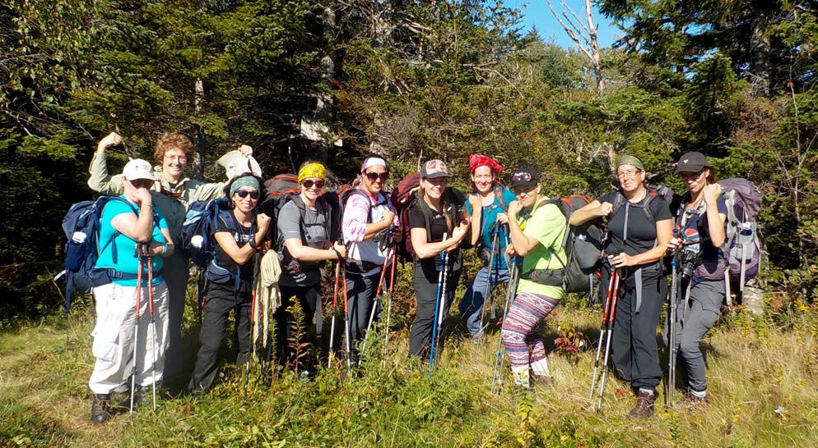
1. Empowerment
Empowerment
Notes:
Abusers set women up for failure. Life is unpredictable and information is withheld. WOC courses set women up for success. Instructors explain what is happening and what will happen. Knowing what is coming is comforting. If someone gets triggered or overwhelmed, instructors help them process what comes up so they can “name it, re-frame it, claim it, and continue.”
Empowerment comes from building confidence and seeing yourself as a competent learner. Ours is an experiential learning approach: we learn best by doing, in real time, with real life consequences, and then reflecting on what that means now and in our future.
Many have come from situations where they have been treated as stupid. However on a WOC course, Whether dinner gets burned or women lose the path in navigating, they are never criticized, ridiculed or condemned. Louise Karch tells this story: “I will always remember one woman’s reaction to being allowed to learn without judgement, blame or shame. My afternoon of patience and lack of anger was astounding to her; she had never experienced that in her life. WOC provides judgement-free learning, which fosters competence and accomplishment.”
Participants have numerous opportunities to learn new skills within a supportive group, set and meet personal goals through a “challenge by choice” model, practice saying No!, and speaking up and speaking out. With practice, the language we use to describe ourselves no longer fits as we come to appreciate our strengths and abilities.

Slide 8
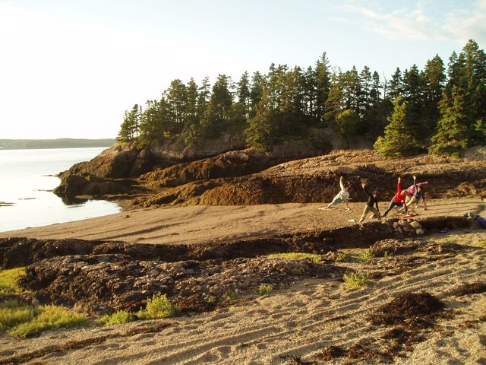
2. Embodiment
Notes:
In this program, the body is at the centre of the experience and this physical awareness expands into our emotions, thoughts, and spirit. The goal is to aid in the re-integration of the mind and emotions with the body: being fully in your body, and being emotionally and mentally present.

Slide 9
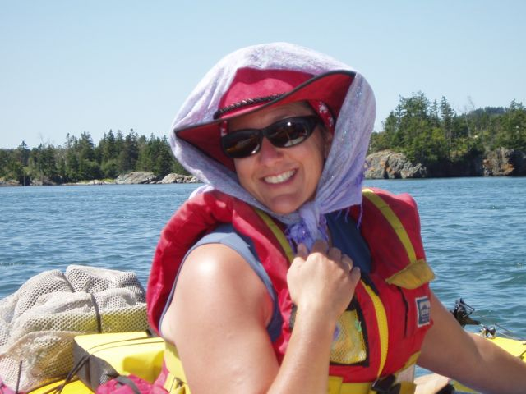
3. Compassion and Service to self
Notes:
Where traditional Outward Bound courses understand service as community service for others, The WOC course directs women to become self-aware. We ask: What does it mean to appreciate yourself, care for yourself, value and protect yourself. We recognize that there is a difference between being self-absorbed, which tends to lead nowhere, and being self-aware, which is essential for growth and well-being. Further, women are often socialized to think of others first and put themselves and their needs last. For survivors this can create an extreme disconnection with the self.
Self care becomes a major theme in the journey as women experience daily physical effort that may produce unfamiliar discomfort. Women are invited to share their insights as they gain physical mastery of skills and the thrill of both personal and group achievements that are emotionally fulfilling. Belly laughs, tears, play, and moments of joyful wonder are common and are jointly celebrated.

Slide 10
What does a course look like?
Notes:
Activities include backpacking, wilderness camping and all the skills this requires, shelter building, navigation, and 24 hours (or less) of rest and quiet self-reflection - alone or with others. All these activities constitute what be do. But what matters more is how we do what we do. We move slowly, remembering that the journey IS the destination. Process is more important than product: we debrief as a group near the end of each day to glean insights and celebrate achievements. And we provide journals and daily time for individuals to write or draw thoughts and images that have emerged. We seek to balance group time and individual time.
For each course there are two instructors with 8 to 10 participants. A course director provides back-up and behind the scenes logistical support.

Slide 11
Why we need it?
Abuse is a profound violation of safety
Safety is key to
well-being
Notes:
A Women of Courage course puts safety first. Instructors frame safety as a mindset that each person takes responsibility for. While the instructors ensure that hazards which participants may be oblivious to in the environment are addressed and defenses are put in place for both physical and emotional safety, the participants are shown ways to adopt a safety mindset and strategies of defense that are transferrable to life beyond the course.
It is essential that participants regain confidence in being able to look after themselves and exercise good self care. Instructors model and support this in myriad ways daily.

Slide 12
Trauma fragments the
mind, heart, body, and spirit
We reintegrate the self though immediate, holistic experience.
Notes:
Former WOC instructor Ruth Goldman explains it best :
Ultimately abuse happens to the body. WOC is about deliberately moving women into their bodies so they can experience pleasure, the “good” pain of a hard day’s work, the taste of food, getting dirty and doing physical things that never seemed remotely possible. Through the power of the body, women make many other connections. Women are most taken with the “bodiness” of the instructors. Participants come face to face with fears, take control, lose control,, and all within the emotional and physical safety of the course.
The positive ripple effect of WOC can be seen as concentric rings with the woman’s body at the centre, moving out through emotional energy and then to the mind and spirit. The integration is huge, but it begins and grows out of the connection to the body, after all, for many survivors, the loss of bodily self is one of the most alienating aspects of abuse.” (end quote)
While the course is definitely very physical with all the challenges that come with living in the wilderness. Sleeping on the ground, in a tent, cooking on a fire, hiking with a pack in all weather, maintaining personal hygiene with a trowel in the woods, those physical things are inextricably linked to emotions (like fear, anxiety, boredom, excitement, glee), the mind (learning new things, communicating and self-reflecting), and the spirit (being in awe of the beauty and power of the elements, and marvelling at the world around us).
Our immersion into the natural world and the challenges of living there are intense, holistic, and deeply impactful. The time is given each day for self-reflection is a way to slow down and process internally what has been experienced. In this way, reintegration begins.

Slide 13
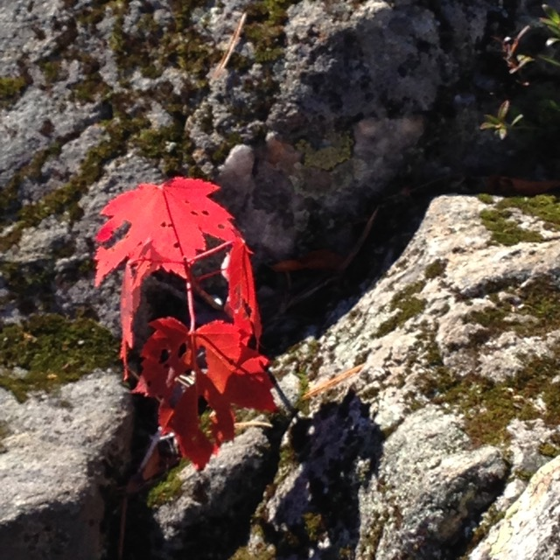
Principles of approach
1. The natural world
is a healing place
Notes:
Research tells us that when we lose our connection to the natural world, illness in any form can take root. Quoting Louise Karch: “With abuse you look away, With WOC courses you look closer. Women find themselves in the middle of the wilderness face to face with nature’s power and beauty. Being in the now means not being consumed by the past or fearing the future. WOC courses give the gift of the present.” end quote.
Just being immersed in nature intimately and for a significant amount of time releases tension and expands our sense of self and possibilities. It allows the soft animal part of ourselves to let go and just BE.

Slide 14
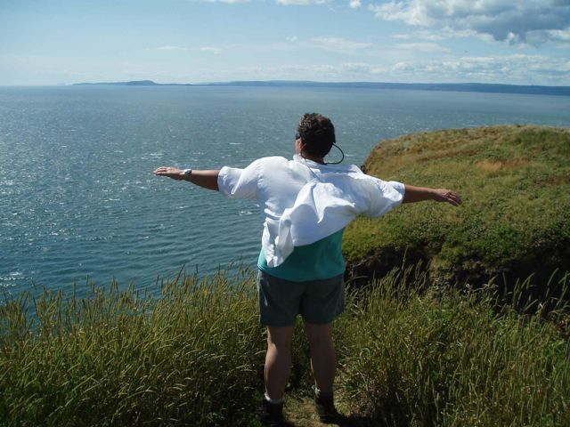
2. Growth requires risk. Adventure is all about risk.
Notes:
In the adventure education biz there is an expression: “Not enough risk kills the adventure. Too much risk kills the adventurer” We talk often about comfort zones and stepping out of our comfort zone. This is the area where most of our growth takes place and we think of it as the learning zone. It is usually uncomfortable and a little scary, but the more we dwell in that place the larger our comfort becomes. When we go past the zone of learning, we hit a wall we refer to as the Panic Zone. I’m sure you’ve all been there: This is where no useful growth takes place because we are either in fight, flight or freeze mode. We are unable to hear and our actions are instinctual and kneejerk.
Challenge by choice is a term we use when we are in that learning place beyond our Comfort zone. Challenge by choice means that each person gets to explore their growing edges while knowing there are people who have their back.
Even with all the support and people challenging themselves respecting their limits, crises do happen. Sometimes daily. There are meltdowns. The key thing we encourage participants to remember is that we can have strong feelings… and then we have lunch… and then we move on. We come to learn that this is a part of life and growth. This normalization helps us understand that stresses are manageable and through that, we gain resilience.

Slide 15
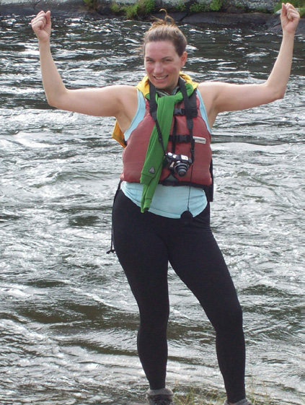
3. Locus of control stays with each woman
Notes:
If a participant is invited to do an activity for which she says “No” - she is listened to. That said, the only exception is if there is a question of safety – but this too is discussed in terms of how we defend ourselves from hazards. Sometimes when feeling scared to take on a challenge, women just need to talk about options or adaptations. This promotes creative thinking and builds a sense of agency. Continually, participants are called to make choices and decisions about how they wish to proceed. Maintaining an internal locus of control becomes a habit.

Slide 16
4. Experience is embodied
Notes:
The physical nature of living outdoors allows us to be more fully in our bodies, even with discomforts and unfamiliar levels of movement. All of our senses open up. We need these senses, and in many ways we delight in our senses with good food, smelling the salt sea, feeling of the sun’s warmth on our shoulders, and bathing in the sounds of surf and wind. Physical pain is, at various points, a reality and we discuss the difference between good pain and bad pain. Even while we may have a blisters on our heels that doesn’t stop us from dancing..

Slide 17
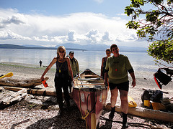
5. Support is essential
Identifying
Asking/receiving
Offering/ Giving
Owning
Notes:
Support is a major theme. It is often difficult for women who have sustained prolonged abuse in domestic situations to ask for support and sometimes to even imagine it
Instructors model support. We are very careful not to “do for” the women when they can do for themselves with some support. When someone says, “I want to, but I can’t,” While they always have the option of saying no, we may ask: what kind of support would make it possible for you to do this thing?” We encourage them to think about what kind of support they need and then ask for it. They get to choose the kind of support, when they need it, and from whom.
Asking for support is seen as a strength, not a weakness.
Owning one’s ability to ask for and receive, offer and give support is an empowerment and life skill to take pride in. Through this we come to genuinely own our capacity for compassion, caring, and generosity.

Slide 18
6. Break down isolation
Notes:
A WOC course is about connecting: connecting with ourselves, with others and with the world we live in. We create a community that breaks down isolation and counters feelings of unworthiness for companionship. Women start trusting one another more. Deep conversations start taking place. We are listened to, our stories are validated. We hear the stories of others and see common threads and hear of different ways of thinking and feeling. Through well-timed and facilitated sharing, we start to feel a sense of genuine belonging.
Note: We do not encourage disclosures of abuse or dwelling on the past, though we also do not censor. (Working on memory and articulating the past is the work of therapy.) Rather, we steer the conversation to the present, what women want now for themselves, and how they might be able to get where they want to go in their lives.

Slide 19
7. Being present in the moment
Notes:
Being fully present and in the moment is difficult at the best of times, but for those who live with hyper vigilance, it can be very challenging. Attention is given to making sure participants are getting enough rest and maintaining at atmosphere of quiet reflection at points throughout the day. Mindfulness and relaxed breathing are tools for self-care that instructors demonstrate and then encourage.

Slide 20
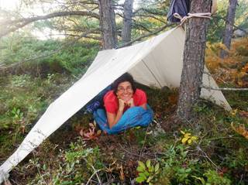
8. Self-reflection
Notes:
We know that self-reflection is key to learning.
WOC courses use a 24 hour period of reflection. In addition to daily opportunities for reflection, at about day 5 of the 8 day course, participants are invited to take that time to rest, and enjoy quiet time. Most women start processing their experience and reflecting on how they want to go forward. They may choose to go solo, or with a buddy, or stay in base camp near the instructors.
After this period of individual time, we re-convene to enjoy a meal that the instructors have prepared and to share stories. It is always a lively evening!

Slide 21
9. Play!
Notes:
Abuse is not funny. WOC courses are hilarious. We play a LOT! We learn that “laughter is carbonated holiness.” A dear colleague often wore this t-shirt on our courses that wisely stated: “she who laughs, lasts.”

Slide 22
Internal study Impact Statistics
Overall Impact for each of the four characteristics
Resilience: 53% → 83% = 30% change
Connectedness: 77% → 92% = 15% change.
Leadership: 55% → 69% = 14% change.
Compassion: 76% → 87% = 11% change.
Notes:
To assess the impact of our programs, we collected data in 2018 from all funded program participants through an
online survey at the end of their program. (This survey was conducted within the organization.) There were 110 respondents overall with 20 respondents for the Women of Courage program. There were four program categories in the survey:
Women of Courage
Vulnerable Youth and Youth at Risk
Indigenous Youth and Adults – culturally centred.
Veterans
The survey included multiple statements that related to four characteristics that best align with Outward Bound Canada’s overall mission: Resilience, Connectedness, Leadership and, Compassion and respondents were asked to what extent they agreed or disagreed with those statements before and after their course.

Slide 23
Sample qualitative responses
“I deal with stressful events fairly well.” 45% pre-course 95% post-course
“I have friends I’m really close to and trust completely.” 55% pre-course 95% post-course
“It doesn’t take me long to recover from stressful events.” 32% pre-course 58% post course
“I tend to bounce back quickly after hard times.” 50% pre-course 80% post-course
Notes:
These are typical questions the women responded to

Slide 24
Women of Courage Impacts
Resilience: 42% → 78% = 36% change
(30% overall. Difference of 6% higher)
Connectedness: 77% → 95% = 18% change
(15% overall. Difference of 3% higher)
Leadership: 42% → 78% = 36% change
(14% overall.. Difference of 22% overall higher)
Compassion: 87% → 88% = 1% change
(11% overall. Difference of 1% higher)
Notes:
* these are the results of 20 survey responses by OBC Women of Courage course participants in
2018, all of whom were provided funding to participate.
For all groups, resilience shows the greatest degree of change in self perception. For the Women of Courage group this is especially true with a 6% higher growth rate of an already high level of change. Similarly, Connectedness also scores highly overall with all groups and even higher for the women.
When looking at a comparison with the other program participants, most noteworthy are the broader splits between Leadership and Compassion. This suggests that self identified feelings about their Leadership capacities are higher as women gain confidence to take control and take on leadership roles and expectations within their group. The lower growth rate in compassion (already starting high) would indicate that for women who are typically already aware of the needs of others, often at a cost to compassion for self and with a higher level of common experience, that compassion starts high and remains about the same.

Slide 25
“You have no idea the impact these programs have on those of us who take them - ‘life changing’ is an understatement. They help us go from surviving to thriving. I can not say enough about how amazing that is.”
- Suzanne, Women of Courage participant

Slide 26
Reference
MacKenzie, Marcia R. (2000). “Gaining a Better Understanding of How Outward Bound Western Canada Course Outcomes are Achieved: A Research Study.” M.Ed. Thesis. Brock University, St. Catherine’s ON.
Notes:
MacKenzie, Marcia R. (2000). “Gaining a Better Understanding of How Outward Bound Western Canada Course Outcomes are Achieved: A Research Study.” M.Ed. Thesis. Brock University, St. Catherine’s ON.

Slide 27
Contact and Information
Phone: 1-888-688-9273 extension 210
Email: woc@outwardbound.ca
Website: www.outwardbound.ca
Notes:
You can find more information by contacting the Outward Bound Canada office in Toronto or on their website.
I’ll now open the floor for questions and discussion.

